Slide 1
Analyzing play calling in the national football league
Priyam Patel
INFO 550

Slide 2
Motivations

Slide 3



Data sources (Rejected)
Pro Football Reference
Box score data, player data, game play-by-play, season data
Individual tables of data exportable as csv files
Limited to 500 plays at a time, requires tedious manual filtering to compile data for a season
Twitter
rtweets package – very useful for streaming tweets or searching for recent tweets on topics, but no date filter

Slide 4
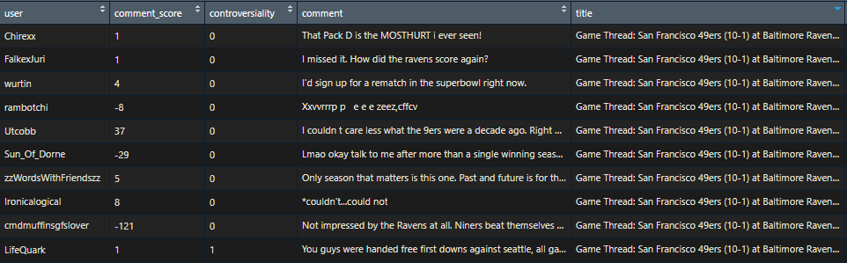
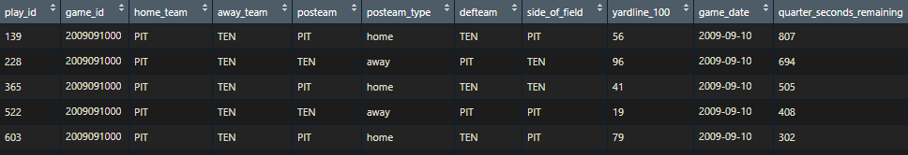
Data sources (accepted)
NFL.com API
nflscrapR – contains functions to pull, parse, and clean data from the publicly-available NFL.com API
Includes player statistics, box scores, game play-by-play, and season play-by-play
256 features
Reddit
reddit.com/r/nfl – contains “Game Threads” for each of the 256 regular season games and 11 playoff games
18 features

Slide 5
Relevant websites

Slide 6
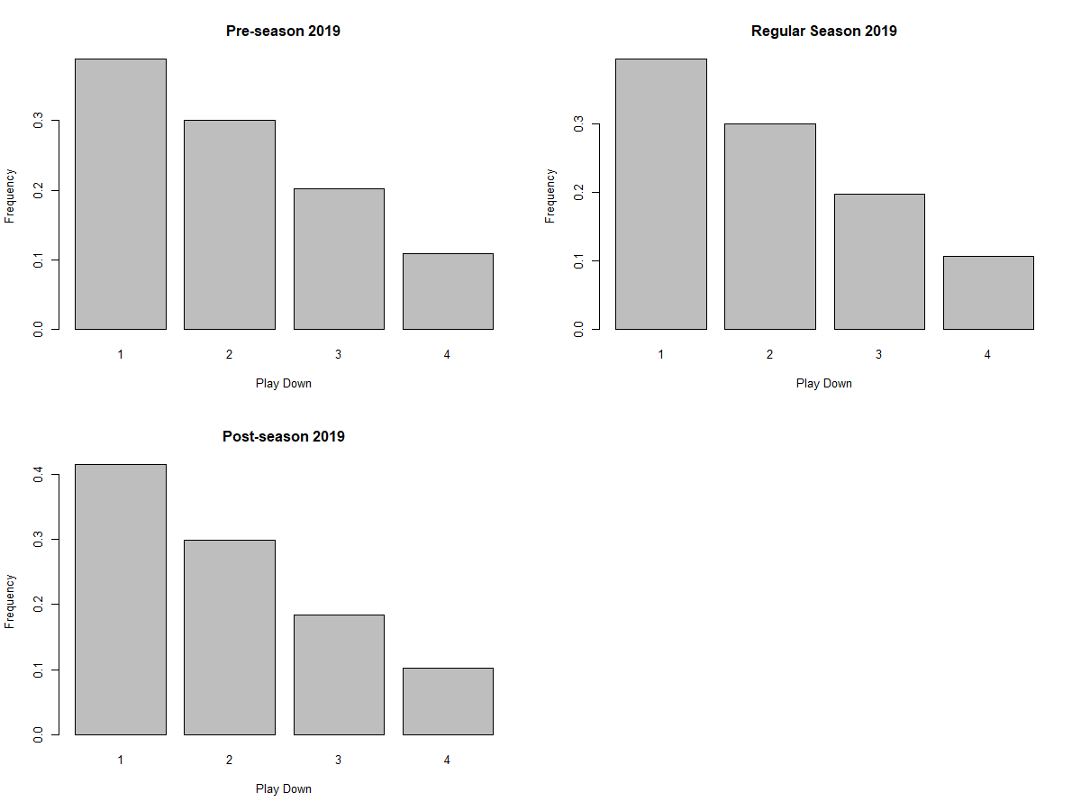
data exploration
Experimented with data storage options
csv versus rds for functionality
Best option for dynamic application?
Explored 2019 season play-by-play data with dplyr
Created basic visualizations to better understand data
Scraped Reddit NFL game threads to get a sense of API limitations

Slide 7
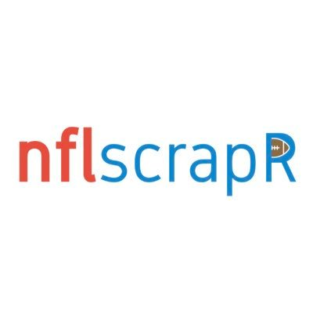

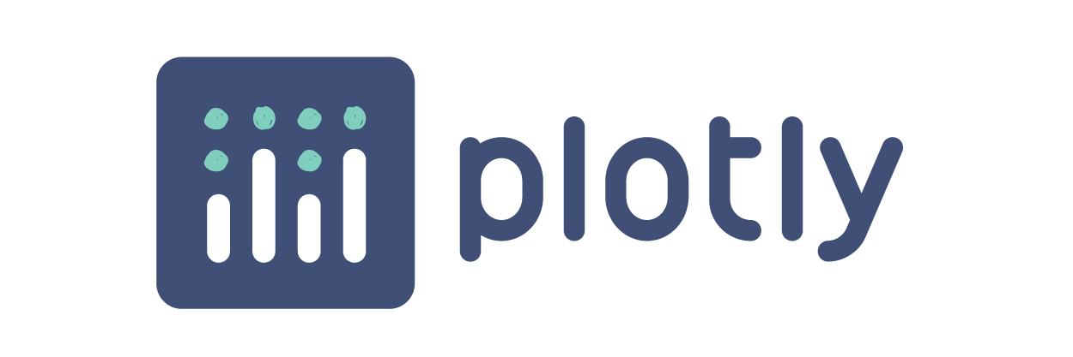
R packages
tidyverse
ggplot2, dplyr, tidyr, readr, stringr
shiny
plotly
nflscrapR
RedditExtractoR

Slide 8
Research questions
How does play calling per down/distance from the endzone change from preseason to postseason? Over the years and by team?
In the post-season, what is the most effective playcall for each down and distance (non-redzone plays)?
How did public sentiment about a team change after risky playcalls in the 2019-20 season?

Slide 9
Anticipated direction
Develop a Shiny web application (or Shiny document) to answer the research questions with dynamic visualizations and analysis
How does play calling per down change from preseason to postseason? Over the years and by team?
Develop reactive plot from NFL data
In the post-season, what is the most effective playcall for each down and distance (non-redzone plays)?
Create model using NFL data that incorporates playcall, down, distance, and potentially other variables
How did public sentiment about a team change after risky playcalls in the 2019-20 season?
Use NFL data to identify games with “risky playcalls,” conduct sentiment analysis of related Reddit Game Threads

Slide 10
Questions?

